Slide 1
Elizabethtown College Student Wellness Center Design
By: Anthony Davala, Brian Brennan, & Greyson McDonald
Notes:
A

Slide 2
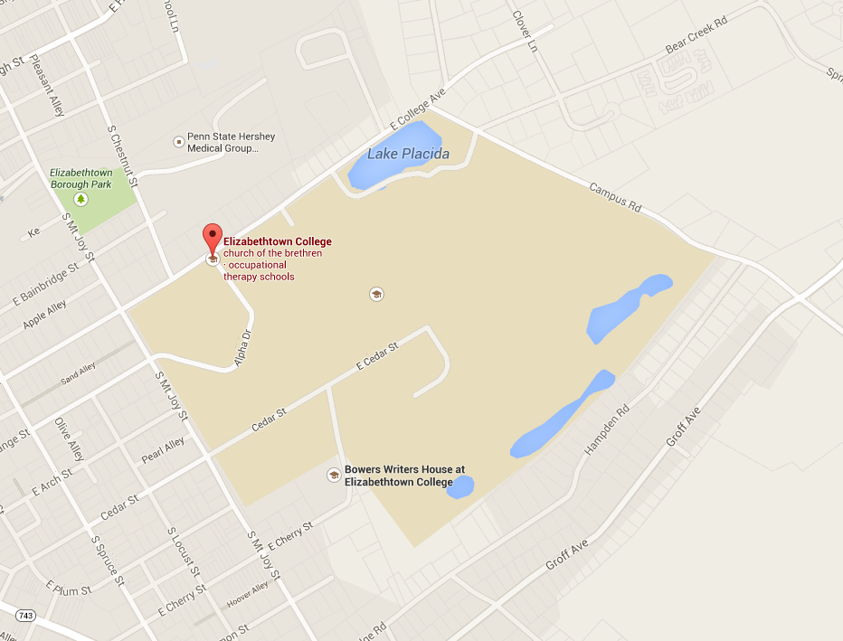
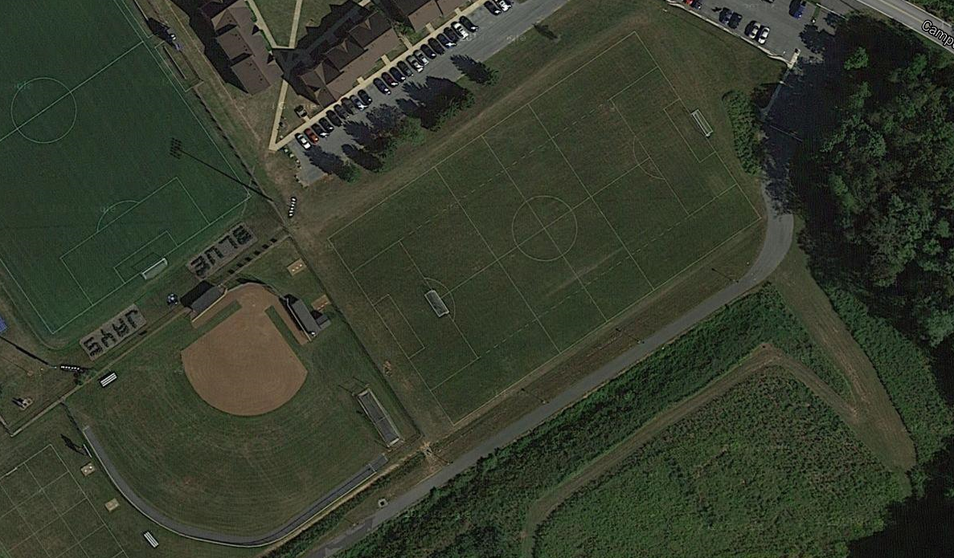
Site Selection
Specs
Behind Quads
On practice soccer field/softball field
Notes:
G

Slide 3
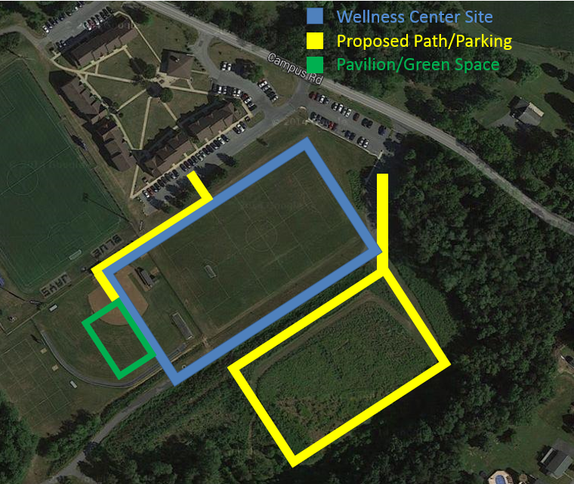
Size/Location
Specs
300 x 180
2 Stories
Raised Center for Basketball Court/Track
Easily Accessible Location
Notes:
G

Slide 4
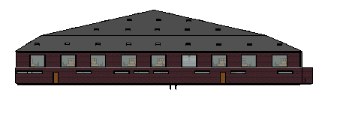
Exterior
Specs
Notes:
G

Slide 5
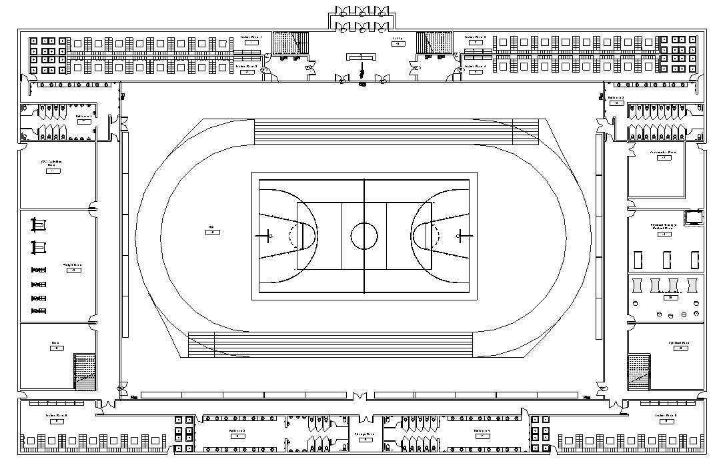
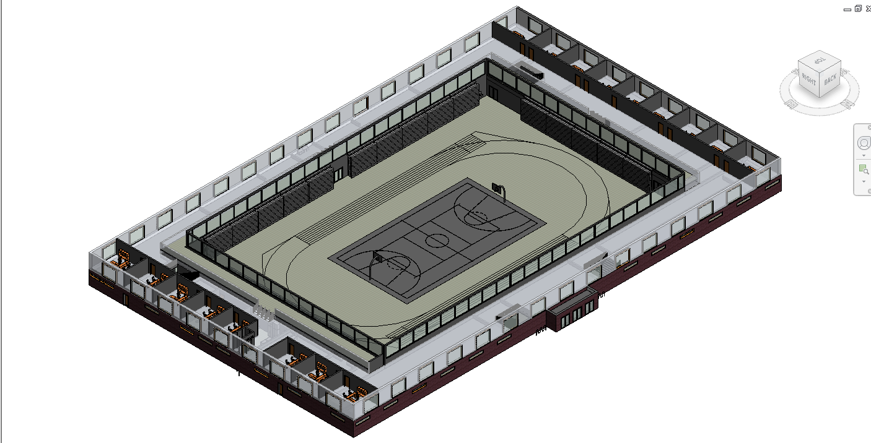
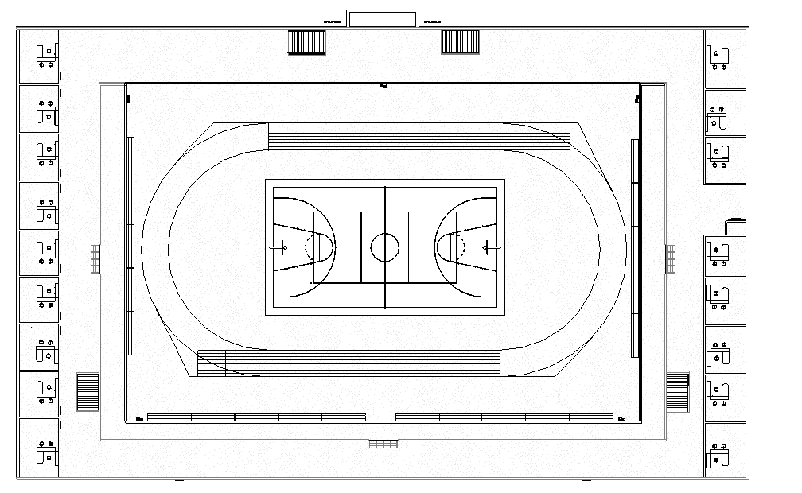
Interior
Specs
Notes:
A

Slide 6
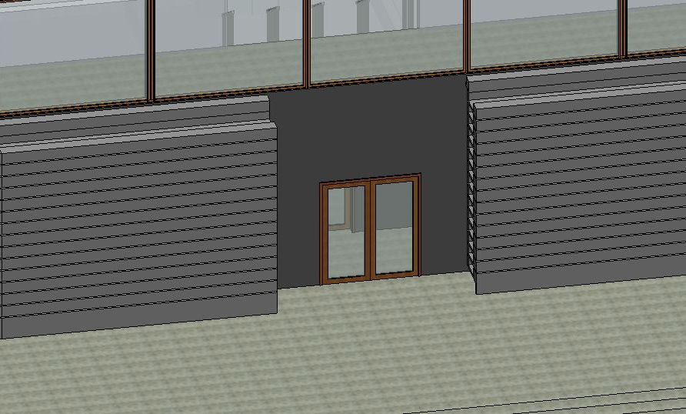
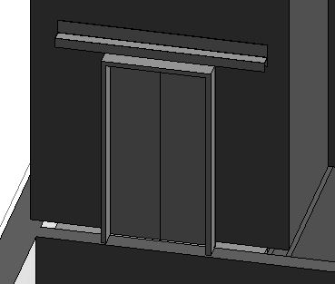
Features
Specs
Elevators
Stairs
Brita Water Stations
2nd floor carpeted for comfortable atmosphere
Folding Bleachers
2nd Floor Balcony
Air-locked Doors
Notes:
A

Slide 7
Second Floor
Mind
Notes:
B

Slide 8
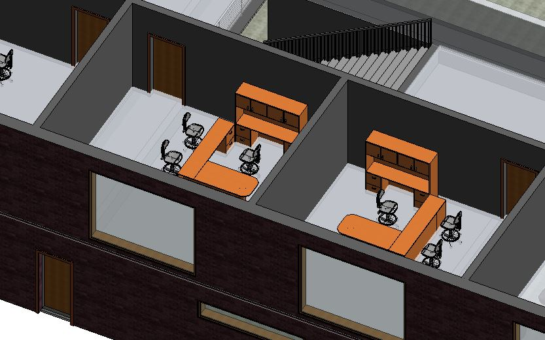
Offices
Mind
Therapy Offices
Coaches Offices
Classroom/Group Study Room
Wellness Office (The Well)
OSA Storage/Office
Couches around Balcony
Outside of Offices
Notes:
B

Slide 9
Large Section of First Floor
Body
Notes:
B

Slide 10
Physical Fitness
Body
Basketball Court
Rubber Indoor Track
Rubber Floor
Weight Room
Physical Training Room
Health Food “Bar”
6 Locker Rooms
3 Men’s & 3 Women’s
Notes:
G

Slide 11
First Floor/Outside
Spirit
Notes:
G

Slide 12
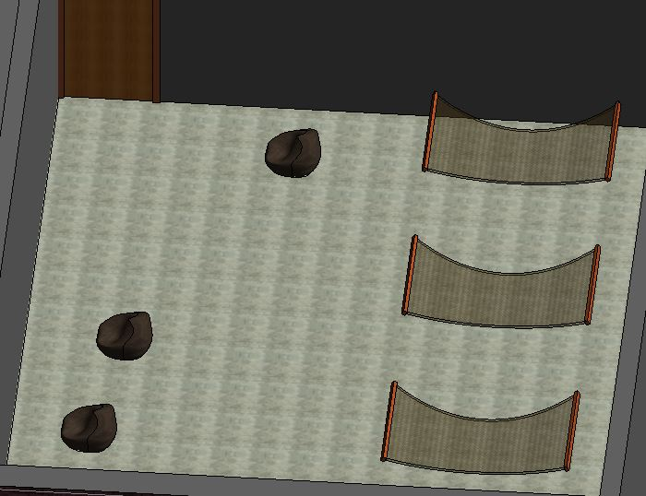
Meditation & Relaxation
Spirit
Relaxation Room
Outside Pavilion
Green Roof
Nature/Green Space
Game Room
Ping Pong, Wii, etc.
Prayer Room
No Affiliation
Garden
Notes:
G

Slide 13
LEED Credit Checklist
LEED
Location and Transportation
Sustainable Sites
Water Efficiency
Energy and Atmosphere
Materials and Resources
Indoor Environmental Quality
Regional Priority
http://metro-acoustics.com/wp-content/uploads/2014/02/leed_logo_web.gif
Notes:
B

Slide 14
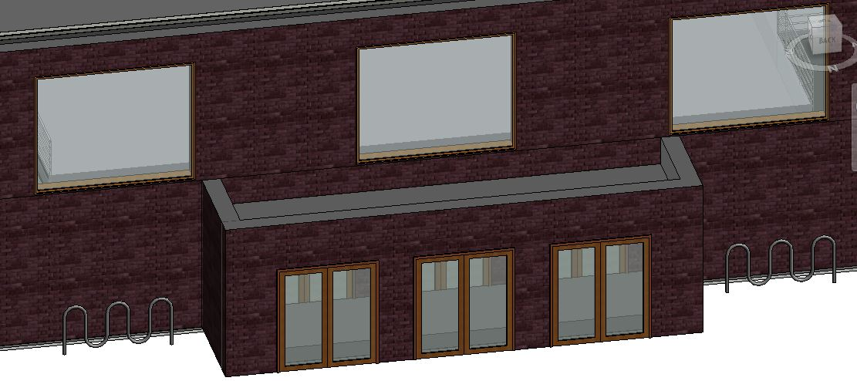
Location and Transportation
LEED
Bike Racks
Path
Small Parking Lots
Notes:
B

Slide 15
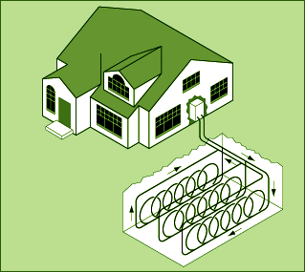
Sustainable Site
LEED
Gutters
Geothermal Loops
Sky Windows
Open Space
http://www.iowageothermal.org/images/closed_loop_system_horiz.gif
Notes:
A

Slide 16
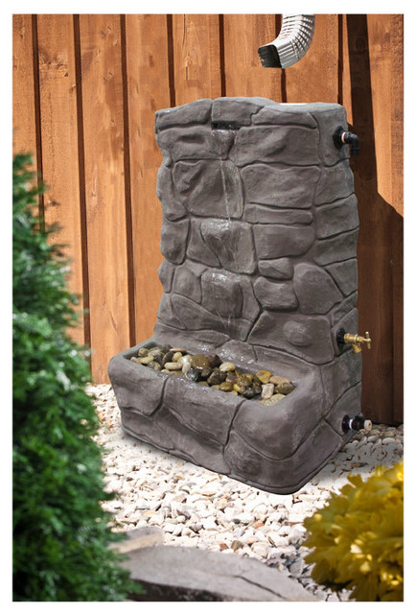
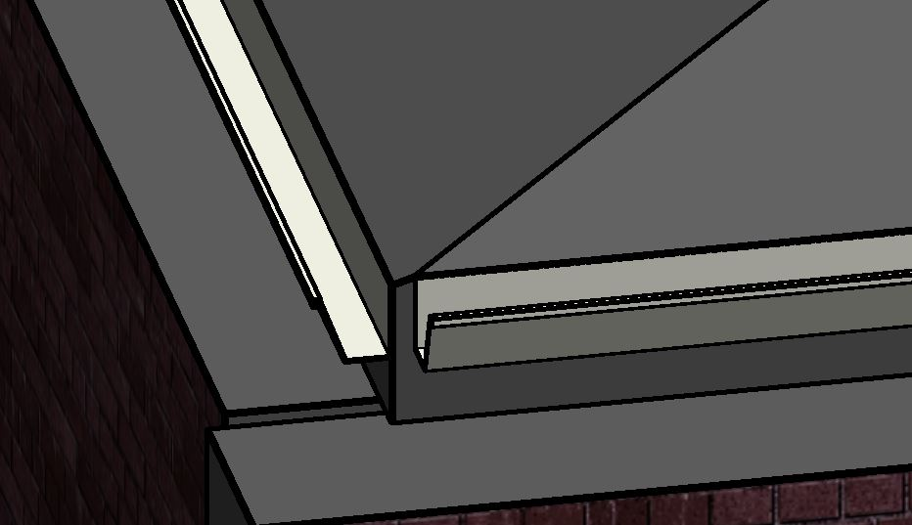
Water Efficiency
LEED
Gray Water Toilets
Outdoor Rain Collectors
Water Metering
http://st.houzz.com/simgs/3d81f7620f8f5b48_4-9675/irrigation-equipment.jpg
Notes:
A

Slide 17
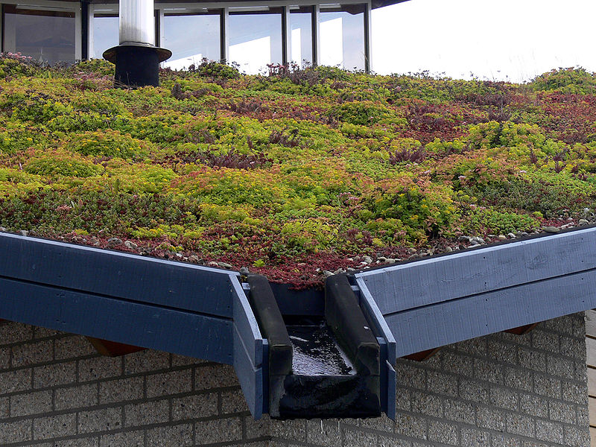
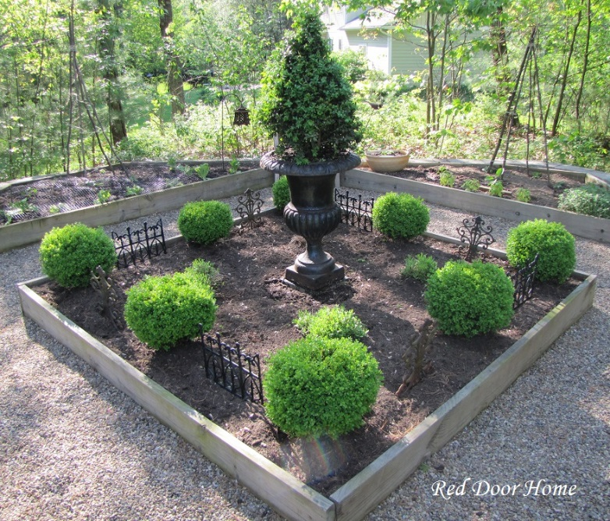
Energy & Atmosphere
LEED
Green Space/Green Roof
Energy Metering
http://3.bp.blogspot.com
http://greenbusinesswatch.org/blog/wp-content/uploads/2013/02/EVA-_Lanxmeer_Green_roof.jpg
Notes:
B

Slide 18
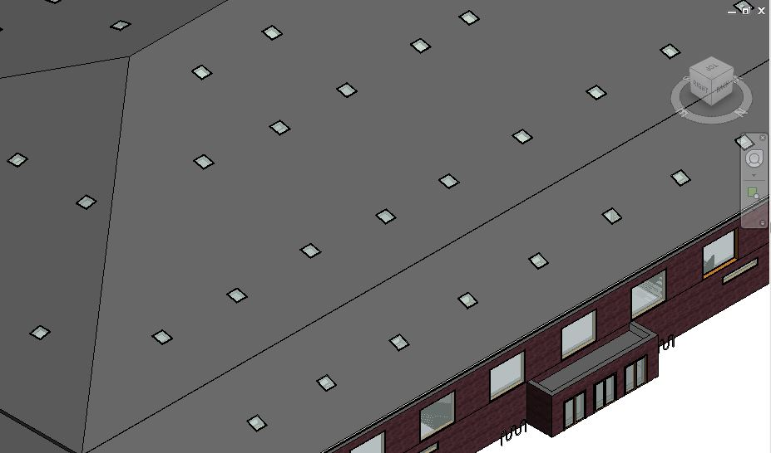
Indoor Environmental Quality
LEED
Insulation/Thermal Comfort
No Smoking Zones Enforced
Natural Interior Lighting
Back-up LED lights
Air-tight Doors
Notes:
A

